Slide 1
Basics of Crypto
Dr. Shachi Natu

Slide 2
Terminologies
Cryptology- art and science of making and breaking secret codes
Cryptography- making secret codes
Cryptanalysis- breaking secret codes
Cipher/ cryptosystem- used to encrypt data
Plaintext- original message
Ciphertext- encrypted text
Key- used to configure a cryptosystem for encryption/decryption

Slide 3
Components of encryption system
Plaintext
Ciphertext
Encryption algorithm
Decryption algorithm
Key (optional)

Slide 4
Types of encryption
Encryption
Symmetric Encryption
Stream cipher
Block cipher
Asymmetric/ Public key Encryption
Substitution cipher
Transposition cipher
Knapsack, RSA, Diffie-Hellman key exchange
A5/1, RC4
DES, AES, Triple DES, RC5, Blowfish
Caesar, Hill, playfair etc.
Rail fence, double transposition

Slide 5
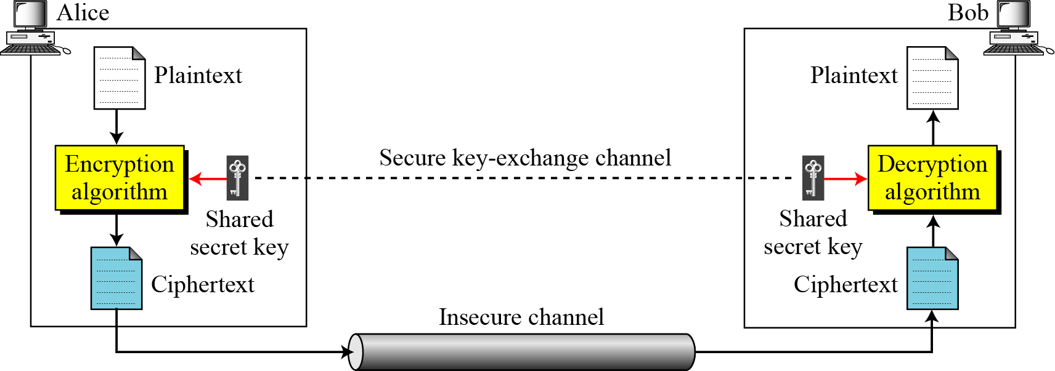
Symmetric key cipher
Figure: General idea of symmetric-key cipher

Slide 6
Asymmetric Key Cryptography
Sender
(A)
Receiver
(B)
Network
Plain text
Cipher text
Cipher text
Plain text
Encrypt with B’s public key
Decrypt with B’s private key

Slide 7
Asymmetric Key Cryptography Example
Customer A
Bank’s public key
Customer B
Bank’s public key
Bank’s private key
Bank
Customer C
Bank’s public key

Slide 8
Difference between symmetric key encryption and Asymmetric key encryption
Criteria | Symmetric key Encryption | Asymmetric key Encryption
Key used for encryption / decryption | Same key is used for encryption and decryption | One key used for encryption and another, different key is used for decryption
Speed of encryption / decryption | Very fast | Slower
Size of resulting encrypted text | Usually same as or less than the original clear text size | More than the original clear text size
Key agreement / exchange | A big problem | No problem at all

Slide 9
Difference between symmetric key encryption and Asymmetric key encryption
Criteria | Symmetric key Encryption | Asymmetric key Encryption
Number of keys required as compared to the number of participants in the message exchange | Equals about the square of the number of participants, so scalability is an issue n(n-1)/2 keys for n participants | Same as the number of participants, so scales up quite well n keys for n participants
Usage | Mainly for encryption and decryption (confidentiality), cannot be used for digital signatures (integrity and non-repudiation checks) | Can be used for encryption and decryption (confidentiality) as well as for digital signatures (integrity and non-repudiation checks)

Slide 10
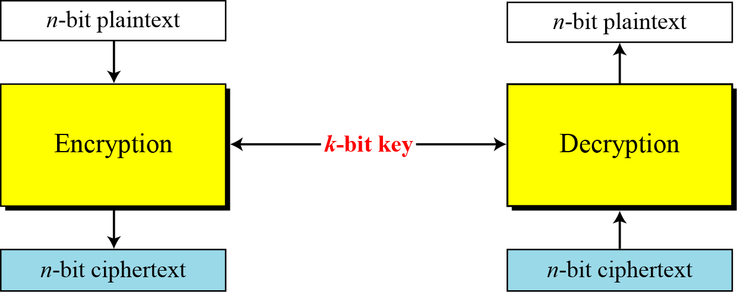
Block cipher
Figure: A modern block cipher

Slide 11
Stream cipher vs Block cipher
Criteria | Stream cipher | Block cipher
Speed of transformation | Fast because each symbol is encrypted without regard for any other plaintext symbol. Each symbol can be encrypted as soon as it is read. Thus time to encrypt the symbol depends only on the encryption algorithm and not on time it takes in receiving other plaintext symbols | Slow because Block cipher needs to wait until entire block of plaintext is received to start the encryption process
Low error propagation | Because each symbol is separately encoded, an error in the encryption process affects only that character | Error will affect the transformation of all other characters in the same block

Slide 12
Stream cipher vs Block cipher
Criteria | Stream cipher | Block cipher
Diffusion | Low diffusion: Each symbol is separately enciphered. Therefore all the information of that symbol is contained in one symbol of ciphertext | High diffusion: Information from plaintext is diffused into several ciphertext symbols. One ciphertext block may depend on several plaintext letters.
Susceptibility to malicious insertions and modifications | Because each symbol is separately enciphered, an active interceptor who has broken the code can splice pieces of previous information and transmit a spurious new messages that may look authentic | Because blocks of symbols are enciphered, it is impossible to insert a single symbol into a block. The length of the block would be then incorrect and the decipherment would quickly reveal the insertion

Slide 13
Confusion
Confusion means that each bit of the ciphertext should depend on several parts of the key, obscuring the connections between the two.
The property of confusion hides the relationship between the ciphertext and the key.
It makes difficult to find the key from the ciphertext and if a single bit in a key is changed, the calculation of the values of most or all of the bits in the ciphertext will be affected.
Confusion increases the ambiguity of ciphertext and it is used by both block and stream ciphers.
Achieved by substitution.

Slide 14
Diffusion
Diffusion means that if we change a single bit of the plaintext, most of the bits in the ciphertext should change, and similarly,
if we change one bit of the ciphertext, then approximately one half of the plaintext bits should change.
It hides the relationship between the ciphertext and the plain text.
It increases the redundancy of plain text by spreading it across the rows and columns
It is achieved through permutation.

Slide 15
Confusion vs. Diffusion
Confusion | Diffusion
In confusion, if one bit within the key is modified, most or all bits within the cipher text also will be modified. | While in diffusion, if one bit within the plain text is modified, many or all bits within the cipher text also will be modified
This technique is possible through substitution. | It is possible through permutation.
In confusion, vagueness is increased in resultant. | While in diffusion, redundancy is increased in resultant.
Both stream cipher and block cipher uses confusion. | Only block cipher uses diffusion.
The relation between the cipher text and the key is masked by confusion. | The relation between the cipher text and the plain text is masked by diffusion.

